Slide 1


Slide 2
MENSURATION

Slide 3
MENSURATION- is a mathematical discipline that deals with the measurement of length, volume, or area of various geometric shapes These shapes can exist in either 2-dimensions or 3-dimensions. Let’s examine the differences between these two.
Difference between 2D shapes and 3D Shapes
2D SHAPE | 3D SHAPE
A 2D shape is defined by three or more straight lines on a plane. | A 3D shape is defined by multiple surfaces or planes.
2D shapes lack depth or height. | 3D shapes, also known as solid shapes, have height or depth.
2D shapes only have two dimensions, namely length and breadth. | 3D shapes have three dimensions: depth (or height), breadth, and length.
Their area and Perimeter can be measured. | Their volume, Curved Surface Area (CSA), Lateral Surface Area (LSA), or Total Surface Area (TSA) can be measured.
In the drawings, these shapes can be seen clearly. For example, in a square, all the edges may be seen. | Due to Overlapping, it is not visible completely. Like , in the case of the cube, it is impossible to show all its edges from a particular angle

Slide 4
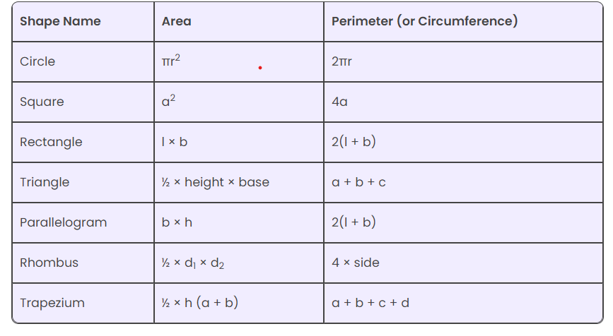
FORMULAS FOR 2D SHAPES

Slide 5
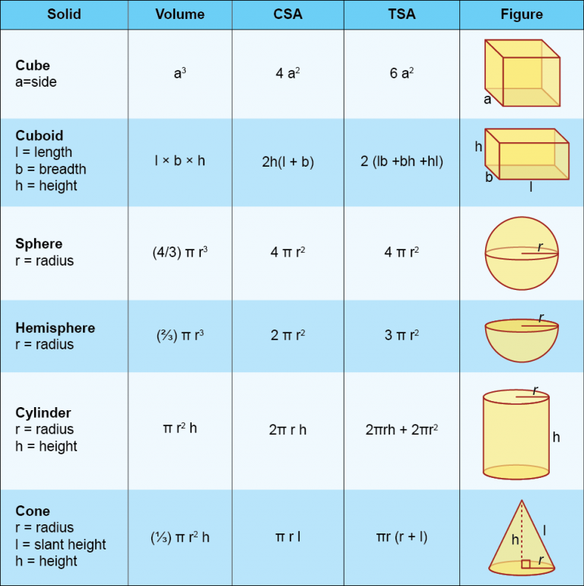
FORMULAS FOR 3D SHAPES

Slide 6
QUESTION 1
A rectangle with perimeter 50 cm has its sides in the ratio 1:4. What is the perimeter of a square whose area is the same as that of the rectangle? A) 36 cm B) 50 cm C) 40 cm D) 45 cm
Notes:
C
Let sides of the rectangle x and 4x Now, 2(x + 4x) = 50 5x = 25 x = 5 So, area of the rectangle = 4x^2 = 4 x 25 = 100 a2 = 100 a= 10 So, Perimeter = 4 x 10 = 40cm The perimeter of the square 40 cm

Slide 7
QUESTION 2
A wire is bent to form a square of area 169 cm^2 .lf the same wire is bent to form a circle, then what is its area (in cm^2 , to the nearest whole number)? A) 285 B) 275 C) 215 D) 227
Notes:
C
Area of the square = a^2 a^2 = 169 a= ± 13 Side of the square = 13 cm When a wire is bent to form a square and then a circle, the perimeter of both the figures will be equal. 4a = 2pir 4*13 = 2 x 22/7 x r r = (13 x 7)/11 Area of the circle = pir^2 =22/7x(13x7)/11 x(13x7)/11 =2366/i11 =215.09 cm^2 :. Area of the circle = 215 cm^2 (nearest to a whole number)

Slide 8
QUESTION 3
The breadth of rectangular field is two - thirds of it length. If its area is 864 m^2 then find the cost of fencing it all around at Rs. 15/m ? A) Rs. 2,000 B) Rs. 1,600 C) Rs. 1,800 D) Rs. 2,400
Notes:
C
Let the length be 3x The breadth will be 2x according to the question Area of rectangle = 864 3x * 2x = 864 6x^2 = 864 x^2= 144 x= 12 Length = 3x = 36 m Breadth = 2x = 24 m Perimeter of the rectangle = 2 x 60 = 120 m Total cost of fencing = 120 x 15 1800 rupees

Slide 9
QUESTION 4
The ratio of the areas of two triangles is 4 : 3 and the ratio of their heights is 3 : 4. The ratio of their bases is______?
A)16:3 B)10:4 C)16:9
D)11:15
Notes:
C
Let the bases of the triangles be b1 and b2, and their heights be h1 and h2. Ratio of areas = (1/2 x b1 x h1)/(1/2 x b2 x h2) = 4:3 b1 x h1/b2 x h2=4:3 Given ratio of heights = 3 : 4 =h1/h2 = 3:4 =b1/b2 x (3/4)=4:3 =b1 /b2 = (4/3) x (4/3) =bl/b2 = 16:9 The ratio of their bases is 16:9

Slide 10
QUESTION 5
The area of a triangle is 480 cm^2 and the ratio of its sides is 10:24:26. What is the perimeter of the triangle?
A) 120 cm B) 230 cm C) 150 cm
D) 180 cm
Notes:
A
Shortcut Trick Recognize that the given triangle has side lengths in the ratio 10:24:26. That is it is a triplet, hence it is a right-angle triangle. Use the formula for the area of a triangle: Area = (base * height) / 2. Given that the area is 480 cm2, Let’s assume the base is 10x and the height is 24x. =(10x* 24x)/2=480. x^2 = 4 x = 2 Calculate the perimeter of the triangle by summing the side lengths: 10x + 24x + 26x = 60x. 60*2 = 120 Therefore, the perimeter of the triangle is 120 cm

Slide 11
QUESTION 6
Two small circular grounds of diameters 42 m and 26 m are to be replaced by a bigger circular ground. What would be the radius of the new ground if the new ground has the same area as two small grounds?
A) 23.65 m B) 25.21 m C) 24.63 m D) 26.73 m
Notes:
C
The radius of the 1st circle R1 = 42/2 = 21 m The radius of the 2nd circle R2 = 26/2 = 13 m Total Area of the two small ground = pi(R1^2 + R2^2) = pi(21^2 + 13^2) = pi x (441 + 169) Total area = 610pi m^2 New ground area = 610pi 610pi =piR^2 =R^2= 610 R=24.63 m The radius of the new ground if the new ground has the same area as two small grounds is 24.63 m.

Slide 12
QUESTION 7
A solid cube having volume 46656 cm^3 is cut into 27 cubes Of equal volume. The surface area (in cm^2) Of the smaller cubes is: A) 864 B) 756 C) 936 D) 921
Notes:
A)
Volume of smaller cube = (46656/27) 1728cm Now, Volume of cube = a^3 = 1728 a = 12cm Now, Surface area of smaller cubes = 6a^2 (6 x 12 x 12) cm^2 864 cm^2 :. The surface area of the smaller cubes is 864 cm^2

Slide 13
QUESTION 8
A solid metallic sphere of radius 12 cm is melted and recast into a cone having diameter of the base as 12 cm. What is the height of the cone?
A) 258 cm B) 192 cm C) 166 cm D) 224 cm
Notes:
B
According to the question. The volume of the sphere = Volume of the cone 4/3pi12^3 = 1/3pi6^2h 4 x 12^3 = n6^2h 4 x 48 = h h = 192 So, height = 192 cm The height of the cone is 192 cm.

Slide 14
QUESTION 9
A hemispherical bowl made of iron has inner diameter 84 cm. Find the cost of tin plating it on the inside at the rate of
Rs. 21 per 100 cm^2 correct to two places of decimal. A) Rs. 2,328.48 B) Rs. 2,425.48 C) Rs. 2,525.60 D) Rs. 2725.65
Notes:
A
Inner Diameter = 84 cm Inner Radius = 84/2 cm = 42 cm Curved Surface area of Hemisphere = 2pir^2 2 x 22/7 x 422 = 2 x 22 x 6 x 42 =11088 cm^2 The cost of tin-plating 100 cm^2 of the bowl = Rs. 21 The cost of tin-plating 1 cm^2 of the bowl = Rs. 21/100 The cost of tin-plating 11088 cm2 area of the bowl = (21/100) x 11088 = Rs. 2,328.48 Thus, the cost of tin-plating is Rs. 2,328.48.

Slide 15
QUESTION 10
A solid cube of side 8 cm is dropped into a rectangular container of length 16 cm, breadth 8 cm and height 15 cm which is partly filled with water. If the cube is completely submerged, then the rise of water level (in cm) is: A)6 B)4 C)2 D)5
Notes:
B
Given: Each side of the cube = 8 cm The rectangular container has a length of 16 cm, breadth of 8 cm, and height of 15 cm Formula used: The volume of cube = (Edge)^3 The volume of a cuboid = Length x Breadth x Height Calculation: The volume of cube = The volume of the rectangular container with a length of 16 cm, breadth of 8 cm, and height of the water level rise Let the height of the water level will rise = x cm So, 8^3 = 16 x 8 x x = 512 = 128 x x x= 512/128=4 The rise of water level (in cm) is 4 cm

Slide 16
QUESTION 11
Ratio of the radius of the cylinder to radius of the sphere is 2: 1 and height of the cylinder is 100% more than that of the radius of the cylinder. Difference between the surface area of the sphere and cylinder is 770 cm2. If the radius of the cylinder is equal to the radius of the cone and the height of the cone is 24 cm, then what is the slanting height of the cone?
A)18 cm B)20 cm C)16 cm D)25 cm
Notes:
ANS: D
"Radius relationship: Let the radius of the sphere be 'r'. Then, the radius of the cylinder is 2r.
Height of the cylinder: Height of the cylinder = 4r (since it's 100% more than its radius)
Surface area difference:
Surface area of sphere = 4πr²
Surface area of cylinder = 2π(2r)(4r) + 2π(2r)(2r) = 24πr²
Difference: 4πr² - 24πr² = -20πr² = 770 cm²
-20πr² = 770
r² = -770 / (-20π)
r = √(770 / 20π) ≈ 3.5 cm
Radius of cylinder = 2r = 2 * 3.5 cm = 7 cm
Radius of cone = radius of cylinder = 7 cm
Height of cone = 24 cm
Slant height (l) = √(radius² + height²) = √(7² + 24²) = √625 = 25 cm
Therefore, the slant height of the cone is 25 cm."

Slide 17
QUESTION 12
Two right circular cones have heights in the ratio 1:9 and their base perimeters are in the ratio 9:5. Determine their volume (use π = 22/7) A)9:25 B)25:9 C)7:25 D)25:7
Notes:
ANS: 1
"1. Understand the problem:
We have two right circular cones.
Their heights are in the ratio 1:9.
Their base perimeters are in the ratio 9:5.
We need to find their volumes.
2. Find the ratio of their radii:
Let the radii of the two cones be r1 and r2.
Since the base perimeters are in the ratio 9:5, we have: (2 * π * r1) / (2 * π * r2) = 9/5 r1/r2 = 9/5
3. Find the ratio of their volumes:
The volume of a cone is given by: (1/3) * π * r^2 * h
Let the volumes of the two cones be V1 and V2.
V1/V2 = [(1/3) * π * r1^2 * h1] / [(1/3) * π * r2^2 * h2]
V1/V2 = (r1/r2)^2 * (h1/h2)
Substituting the given ratios: V1/V2 = (9/5)^2 * (1/9) V1/V2 = 81/225 * 1/9 V1/V2 = 9/25
Therefore, the volumes of the two cones are in the ratio 9:25."

Slide 18
QUESTION 13
The ratio of the heights of a right circular cone and a right circular cylinder is 4:3 and the ratio of the radii of their bases is 7:3. If the volume of the cylinder is 810 cm3, then the volume (in cm3) of the cone is: A)1960 B)1961 C)1955 D)1966
Notes:
ANS: 1
"1. Set up the ratios:
Heights: Let the height of the cone be 4x and the height of the cylinder be 3x.
Radii: Let the radius of the cone be 7y and the radius of the cylinder be 3y.
2. Find the volume of the cylinder:
Volume of cylinder = π * (radius of cylinder)² * height of cylinder
810 = π * (3y)² * 3x
810 = 27πxy²
πxy² = 30
Volume of cone = 1/3πr²h
1/3 * 49 * 4 * πxy²
49*4*10
1960

Slide 19
QUESTION 14
Cylindrical cans of cricket balls are to be packed in a box. Each can has a radius of 7 cm and height of 30 cm. Dimension of the box is l = 76 cm, b = 46 cm, h = 45 cm. What is the maximum number of cans that can fit in the box?
A)15 B)17 C)22 D)21
Notes:
ANS: 4
"Each cylindrical can has a diameter of 14 cm and while they are kept erect in the box will occupy height of 30 cm
Number of such cans that can be placed in a row = l/Diameter
= 76/14 = 5 (Remaining space will be vacant)
Number of such rows that can be placed = Width/Diameter
= 46/14 = 3
Thus 5 * 3 = 15 cans can be placed in an erect position.
However, height of box = 45cm and only 30 cm has been utilized so far
Remaining height = 15 cm > 14 cm (Diameter of the can)
So, some cans can be placed horizontally on the base.
Number of cans in horizontal row = Lengthofbox/Heightofcan
= 76/30 = 2
Number of such rows = Widthofbox/Diameterofcan
= 46/14 = 3
∴ 2 * 3 = 6 cans can be placed horizontally
∴ Maximum number of cans = 15+6 = 21
The question is ""What is the maximum number of cans that can fit in the box?""
Hence, the answer is 21."

Slide 20
QUESTION 15
A hollow spherical shell is made of a metal of density 6 g/cm^3. Its internal and external radius are 2 cm and 4 cm, respectively. What is the weight (in kg) of the shell? (Take π = 22/7) A)1.408 B)1.592 C)2.73 D)3.28
Notes:
ANS: 1
"1. Find the Volume of the Shell:
Volume of a sphere: (4/3) * π * r³
Where 'r' is the radius of the sphere
Volume of the outer sphere: (4/3) * π * (4 cm)³ = 268.08 cm³
Volume of the inner sphere: (4/3) * π * (2 cm)³ = 33.51 cm³
Volume of the shell: Volume of outer sphere - Volume of inner sphere
Volume of the shell = 268.08 cm³ - 33.51 cm³ = 234.57 cm³
2. Calculate the Mass of the Shell:
Density: 6 g/cm³
Mass: Density × Volume
Mass = 6 g/cm³ × 234.57 cm³ = 1407.42 g
3. Convert Mass to Kilograms:
1 kg = 1000 g
Mass in kg = 1407.42 g / 1000 = 1.40742 kg
Therefore, the weight of the hollow spherical shell is approximately 1.408 kg."

Slide 21
Question
Three points A, B, and C lie on the circle such that AB is the diameter of the circle. Find the angle measure of C.
○ 120 deg
○ 270 deg
○ 90 deg
○ 25 deg
Notes:
ANS: 90 degree
Angle in a Semicircle Theorem: An angle inscribed in a semicircle is always a right angle (90 degrees).
Applying the Theorem
Diameter: AB is the diameter of the circle.
Inscribed Angle: Point C lies on the circle, and the angle ∠ACB is formed by the points A, C, and B.
Semicircle: Since AB is the diameter, the arc ACB forms a semicircle.
Right Angle: According to the angle in a semicircle theorem, ∠ACB must be a right angle.
The angle measure of C (∠ACB) is 90 degrees.

Slide 22
Question
An order was placed for the supply of a carpet whose breadth was 6 m and length was 1.44 times the breadth. What would be the cost of a carpet whose length and breadth are 40% more and 25% more respectively than the first carpet? Given that the ratio of carpet is Rs. 45 per sq m?
○ Rs. 3642.40
○ Rs. 3868.80
○ Rs. 4216.20
○ Rs. 4082.40
Notes:
ANS: Rs. 4082.40
Breadth = 6 meters
Length = 1.44 * Breadth = 1.44 * 6 = 8.64 meters
New Length = Initial Length + 40% of Initial Length
New Length = 8.64 + (0.40 * 8.64) = 8.64 + 3.456 = 12.096 meters
New Breadth = Initial Breadth + 25% of Initial Breadth
New Breadth = 6 + (0.25 * 6) = 6 + 1.5 = 7.5 meters
New Area = New Length * New Breadth
New Area = 12.096 * 7.5 = 90.72 square meters
Total Cost = New Area * Cost per square meter
Total Cost = 90.72 * 45 = 4082.4 rupees
Therefore, the cost of the new carpet would be Rs. 4082.40.

Slide 23
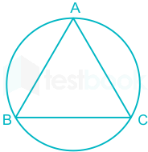
Question
Find the area of the circle circumscribing an equilateral triangle of side 12 units.
○ 150.86
○ 170.86
○ 180.86
○ 190.86
Notes:
ANS: 150.86
In an equilateral triangle with side ‘a’ = 12
Radius of the circle circumscribing an equilateral triangle = side /√3
Radius of circle = 12/√3
= 4*3/√3
=4√3
The Area of the Circle
Area of circle = π * R²
Area = π * (4√3)² = π * (16 * 3) = 48π square units
Using π ≈ 22/7:
Area ≈ 48 * 22/7
Area ≈ 150.8571 square units

Slide 24
Question
Two circles of radius 3 cm and 4 cm are combined to form a circle of the largest possible size. What is the radius of the biggest circle?
○ 7
○ 3.5
○ 3.74
○ 5
Notes:
ANS: 5
Area = π * (radius)²
Area = π * (3 cm)² = 9π square cm
Calculate the area of the second circle:
Area = π * (radius)²
Area = π * (4 cm)² = 16π square cm
Calculate the area of the combined circle:
Combined Area = 9π + 16π = 25π square cm
Area = π * (radius)²
25π = π * (radius)²
25 = (radius)²
radius = √25 = 5 cm
The radius of the biggest circle formed is 5 cm.

Slide 25
Question
The height of a cylinder is to the diameter of the base as 1:2. Find the ratio of the area of its surface to the sum of the areas of its two ends.
○ 1:1
○ 1:2
○ 2:1
○ 1:3
Notes:
Ans: a
Given that, the ratio of height to diameter =1:2. Radius = 1. The new ratio of height and radius =1:1. Curved surface area of a cylinder =2πrh. Areas of two ends is circle =2πr^2
The ratio of area be, = 2πrh/2πr^2 =1:1 Therefore, option 1 is correct.

Slide 26
Question
A man walked diagonally across a square plot. Find the percent saved by not walking along the edges approximately.
○ 20%
○ 24%
○ 30%
○ 33%
Notes:
ANS: 30%
Let side of an square be N.
Diagonal of square = √2 x N = 1.41N
When u walk on two sides of square = 2N
When u walk diagonally = 1.41N
Percentage saving =
= [(2N -1.41N)/2N] x 100
= 29.5
. Percentage saving is 29.5%

Slide 27
Question
A cylindrical can of radius 14 cm and height 20 cm is completely filled with milk. A pipe is opened at the bottom of the can to fill the milk into identical bottles each which has a capacity of 770 ml. How many such bottles can be filled with the milk in the can?
○ 4
○ 12
○ 8
○ 16
Notes:
ANS: 16
Volume of a cylinder = π * (radius)² * height
Radius (r) = 14 cm
Height (h) = 20 cm
Volume = π * (14 cm)² * 20 cm
Volume = π * 196 cm² * 20 cm
Volume = 3920π cm³
π ≈ 22/7:
Volume ≈ 3920 * (22/7) cm³
Volume ≈ 560 * 22 cm³
Volume ≈ 12320 cm³
Convert the volume of the can to milliliters (ml):
1 cm³ = 1 ml
Volume ≈ 12320 ml
Calculate the number of bottles that can be filled:
Capacity of each bottle = 770 ml
Number of bottles = (Total volume of milk) / (Capacity of each bottle)
Number of bottles ≈ 12320 ml / 770 ml
Number of bottles ≈ 16

Slide 28
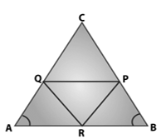
Question
In a ΔABC, P, Q and R are the mid-points of sides BC, CA and AB respectively. If AC = 21 cm, BC = 29 cm and AB = 30 cm. The perimeter of the quadrilateral ARPQ is
○ 91cm
○ 60cm
○ 51cm
○ 70cm
Notes:
ANS:51 cm
Using mid-point theorem,
Hence, ARPQ is a parallelogram.
In a parallelogram, Opposite sides are equal,
AR = QP => 15 cm [ AB = 30cm , AR = 15cm]
RP = AQ => 10.5 cm [AC = 21cm, AQ=10.5cm]
The perimeter is,
P = sum of all sides
Hence the perimeter is 51 cm

Slide 29
Question
A square is drawn by joining mid-points of the sides of a square. Another square is drawn inside the second square in the same way and the process is continued indefinitely. If the side of the first square is 16 cm, then what is the sum of the areas of all the squares?
○ 256 sq. cm
○ 128 sq. cm
○ 512 sq. cm
○ 1024 sq. cm
Notes:
ANS: 512 sq.cm
The side of the first square = a ➔ 16 cm
Side of the second square =a/√2 ➔ 16/√2 =8√2 cm
Side of third square = 8 cm and so on ...
Sum of area of squares = (16)^2 + (8√2)^2 + (8)^2 + ....
➔ 256 +128 =64 +….
If the series is in GP with common ratio r and first term a, then the sum of the infinite = a/1-r
Sum of the area of squares = 256/1-1/2
Sum of the area of squares = 512

Slide 30
Question
A solid metallic spherical ball of diameter 6 cm is melted and recast into a cone with diameter of the base 12 cm. Find the height of the cone.
○ 2cm
○ 3cm
○ 4cm
○ 5cm
Notes:
ans: 3cm
Volume of sphere = (4/3) Pi*r^3
Volume of cone = (1/3)pi*r^2h
Calculation:
Radius x 2 = Diameter
Radius of spherical ball = 6/2 = 3 cm
Radius of cone = 12/2 = 6 cm
Volume of spherical ball = Volume of cone
4/3 pi r^3 = 1/3 pi r^2 h
4/3 * pi *27 = 1/3 * pi *36 * h
Height = 3cm

Slide 31
Question
A cone of height 9 cm with diameter of its base 18 cm is carved out from a wooden solid sphere of radius 9 cm. Find the percentage of the wood wasted.
○ 25%
○ 35%
○ 50%
○ 75%
Notes:
ANS: 75%
Radius of the sphere (R) = 9 cm
Volume of sphere = (4/3) * π * R³
Volume of sphere = (4/3) * π * (9 cm)³
Volume of sphere = (4/3) * π * 729 cm³
Volume of sphere = 972π cm³
Height of the cone (h) = 9 cm
Diameter of the base of the cone = 18 cm
Radius of the base of the cone (r) = 18 cm / 2 = 9 cm
Volume of cone = (1/3) * π * r² * h
Volume of cone = (1/3) * π * (9 cm)² * 9 cm
Volume of cone = (1/3) * π * 81 cm² * 9 cm
Volume of cone = 243π cm³
Calculate the Volume of Wood Wasted
Volume of wood wasted = Volume of sphere - Volume of cone
Volume of wood wasted = 972π cm³ - 243π cm³
Volume of wood wasted = 729π cm³
Calculate the Percentage of Wood Wasted
Percentage of wood wasted = (Volume of wood wasted / Volume of sphere) * 100%
Percentage of wood wasted = (729π cm³ / 972π cm³) * 100%
Percentage of wood wasted = (729 / 972) * 100%
Percentage of wood wasted = (3 / 4) * 100%
Percentage of wood wasted = 75%

Slide 32
Practice
Practice Questions
How many revolutions per minute a wheel of car will make to maintain the speed of 132km per hour? If the radius of the wheel of car is 14cm.
A hemispherical bowl of internal diameter 18 cm contains water. This water is to be filled in cylindrical bottles of diameter 6 cm and height 3 cm. The number of bottles required to empty the bowl is?
A cuboidal tank has 25000 litres of water. If the depth of the cuboid is 1/5 of its length and breadth is 1/8 of its length, then the length of the tank is?

Slide 33
THANK YOU

